Slide 1
Linked List
Data Structures & Algorithms

Slide 2
A Quick Revision . . . .
Suppose we have a long list of integers
position | List Items
1 | 3
2 | 14
3 | 7
4 | 8
5 | 23
6 | 5
. . . | . . .
Array index | Array Elements
0 | 3
1 | 14
2 | 7
3 | 8
4 | 23
5 | 5
. . . | . . .

Slide 3
Cont . . .
Array elements are stored next to one another in memory.
Array index is used to refer to objects of an array.
It may seem natural for storing a list, but it brings some problems.

Slide 4
Cont . . .
Suppose we need to delete the “7” from the list below:
index | List Items
0 | 3
1 | 14
2 | 7
3 | 8
4 | 23
5 | 5
. . . | . . .
Work, work
3
14
7
8
23
5
. . .
index
0
1
2
3
4
. . .
Resulting Array
3
14
8
23
5
. . .

Slide 5
Cont . . . .
Suppose we need to insert the “79” near the front of the list
79
index
0
1
2
3
4
. . .
initial Array
3
14
8
23
5
. . .
Work, work
3
14
8
23
5
. . .
index
0
1
2
3
4
5 . .
Resulting Array
3
14
79
8
23
5
. . .

Slide 6
Cont . . . .
Another problem:
Suppose the array was for storing a list:
int MyArray[200];
When the program runs:
If the list contains few items, than we have been wasteful with memory allocation.
But if the list contains 201 or more items, then our array can’t accommodate the list
So instead of compile time allocation, run time memory allocation is better.

Slide 7
Dynamic memory Allocation
To avoid wasting memory, array allocation or de-allocation can take place at run time
To allocate memory, we need to use the new operator
Reserves the number of bytes requested by the declaration. Returns the address of the first reserved location or NULL if sufficient memory is not available.
To de-allocate memory (which has previously been allocated using the new operator) we need to use the delete operator.
Releases a block of bytes previously reserved. The address of the first reserved location is passed as an argument to delete.

Slide 8
What is a Linked List?
A linked list is a common data structure that is made of a chain of nodes. Each node contains a value and a pointer to the next node in the chain.
The head pointer points to the first node, and the last element of the list points to null. When the list is empty, the head pointer points to null.
A Linked List has three elements:
Head
Nodes
Tail

Slide 9
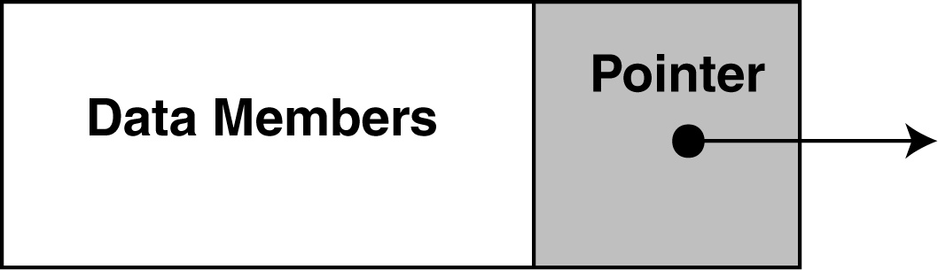
Linked List
Is an alternative to an array
Linked list is a sequence of nodes, in which
Each node contains a data element, and
Each node (except the last) links to a successor node
A linked list can easily grow or shrink in size.
Insertion and deletion of nodes is quicker with linked lists than with vectors

Slide 10
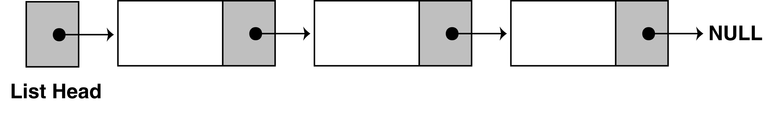
Composition of Linked List
A linked list is called "linked" because each node in the series has a pointer that points to the next node in the list.
List head contains the address of the first node
By convention NULL indicates the end of the linked list

Slide 11
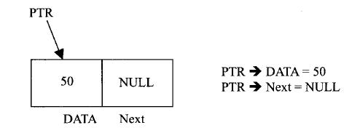
Example
Each node is divided into two parts
First part contains the information of element
Second part contains the address of next node in the linked list

Slide 12
Advantages of Linked List
Linked list is a dynamic data-structure,
it can grow and shrink during execution of the program
Efficient memory utilization
Memory is not pre-allocated.
Insertion and deletion of an element (at arbitrary position) is easier
But
Searching for an element is a bit time consuming

Slide 13
Operations in Linked List
The primitive operations on linked list are:
Creation- is used to create linked list
Insertion-inset node at (beginning, specified position, end)
Deletion-delete node at (beginning, specified position, end)
Traversing-visiting each node from one end to another

Slide 14
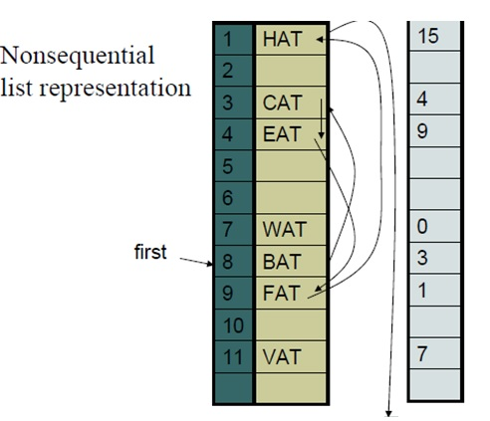
Example

Slide 15
Cont . . .
It is easier to make arbitrary insertions and deletions using linked lists
To insert the data item GAT between FAT and HAT,
Following steps are required.
Get a node that is currently unused; let its address be x.
Set the data field of this node to GAT.
Set the link field of x to point to the node after FAT, which contains HAT.
Set the link field of the node containing FAT to x.

Slide 16
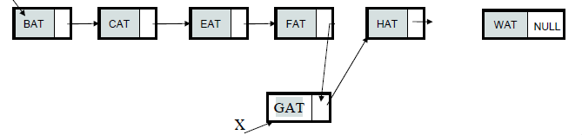
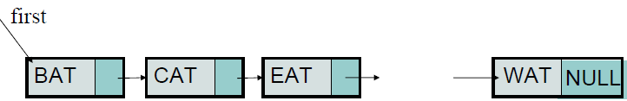
Cont . . . .
First
Since the list starts at data[8] = BAT, let us set a variable first =8, link[8] has the value 3, which means it points to data[3] which contains CAT
Link[3]
Link[4]
Link[9]

Slide 17
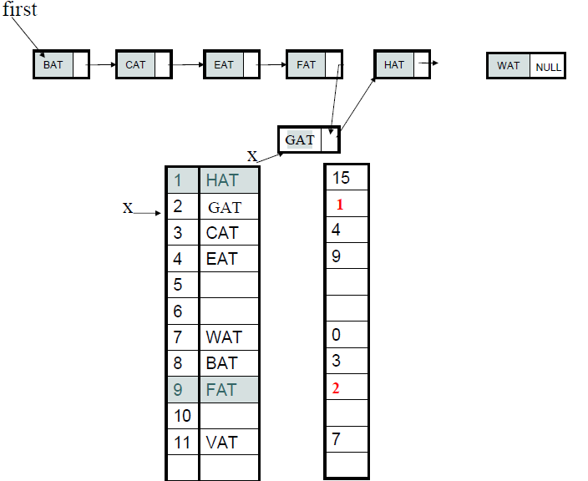

Slide 18
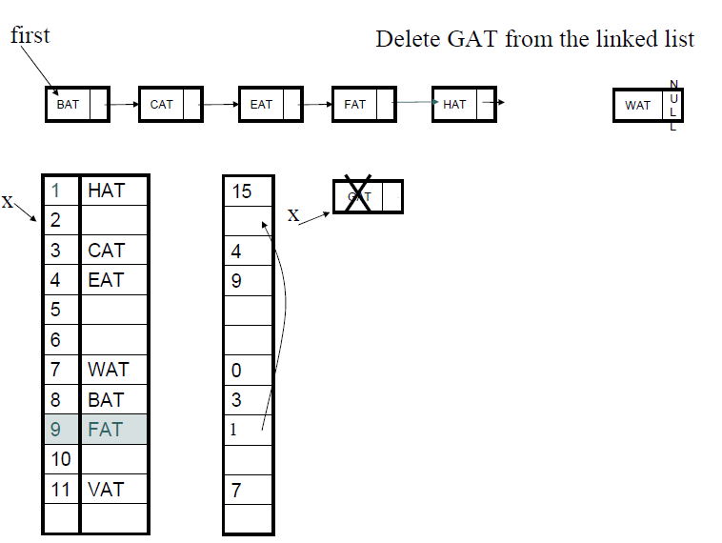

Slide 19
Linked List
Linked lists can dynamically increase in size. It is easy to insert and delete from a linked list because unlike arrays, as we only need to change the pointers of the previous element and the next element to insert or delete an element.
Some important applications of Linked Lists include:
Implementing HashMaps, File System and Adjacency Lists
Dynamic memory allocation: use linked lists of free blocks
Performing arithmetic operations on long integers
Maintaining a directory of names

Slide 20

Types of linked lists
Since a linked list is a linear data structure, meaning that the elements are not stored at contiguous locations, it’s necessary to have different types of linked lists to access and modify our elements accordingly.
There are a three different types of linked lists that serve different purposes for organizing our code.

Slide 21
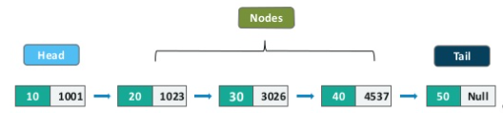

Singly linked list (Uni-directional)
A singly linked list is unidirectional, meaning that it can be traversed in only one direction from head to the last node (tail).

Slide 22

Doubly linked list (Bi-directional)
Doubly linked lists (DLLs) are an extension of basic linked lists, but they contain a pointer to the next node as well as the previous node. This ensures that the list can be traversed in both directions. A DLL node has three fundamental members:
The data
Pointer to the next node
Pointer to the previous node

Slide 23
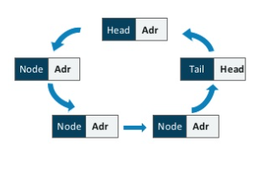
Circular linked list
Circular linked lists function circularly: the first element points to the last element, and the last element points to the first. A single linked list and double linked list can be made into a circular linked list. The most important operations for a circular linked list are:
insert − insert elements at the start of the list
display − display the list
delete − delete elements from the start of the list

Slide 24

Structure of a Singly Linked List
In Java, the linked list class is an ordered collection that contains many objects of the same type. Data in a Linked List is stored in a sequence of containers. The list holds a reference to the first container and each container has a link to the next one in the sequence.
Linked lists in Java implement the abstract list interface and inherit various constructors and methods from it. This sequential data structure can be used as a list, stack or queue.

Slide 25
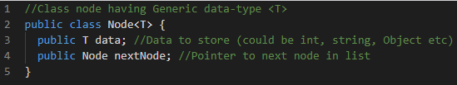
Class Node
To implement a linked list, we need the following two classes:
Class Node
The Node class stores data in a single node. It can store primitive data such as integers and string as well as complex objects having multiple attributes.
Along with data, it also stores a pointer to the next element in the list, which helps in linking the nodes together like a chain.
Here’s a typical definition of a Node class:

Slide 26
Class Linked list
Singly Linked list is made up of nodes that are linked together like a chain. Now to access this chain, we would need a pointer that keeps track of the first element of the list.
As long as we have information about the first element, we can traverse the rest of the list without worrying about memorizing their storage locations.
The Singly Linked List contains a head node: a pointer pointing to the first element of the list. Whenever we want to traverse the list, we can do so by using this head node.

Slide 27
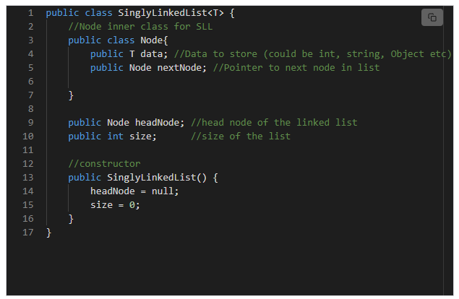

Slide 28
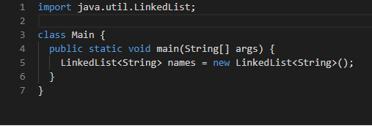
How to create and use a Linked List
Linked lists are fairly easy to use since they follow a linear structure. They are quite similar to arrays, but linked lists are not as static, since each element is its own object. We have initialized an empty Linked List using the new keyword. A Linked List can hold any type of object, including null.

Slide 29
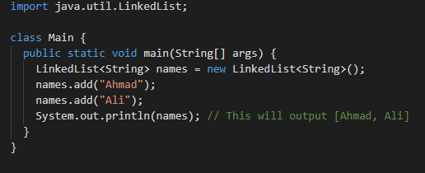
Adding elements to a Linked List
In order to add an element to the list, we can use the .add() method. This method takes an element (passed as an argument) and appends it to the end of the list.

Slide 30

Adding elements to a Linked List at a specific location
If you want to add the new element to a specific location instead, you can do so by passing the index value as the first argument to the .add() method.

Slide 31

Explicitly adding elements to the end or start of the list.

Slide 32

Removing Elements from a LinkedList
Similar to element addition, Linked List provides methods for removing elements in a list. These methods are similar in operation to the methods for adding elements to the list. The .remove() method removes the first occurrence of a specified element.

Slide 33

Removing elements from the start or end of the list.

Slide 34

Updating Elements in a LinkedList
The Linked List class provides a method .set() to change an element in a list. It takes an index and the element which needs to be inserted, replacing the previous element at that position.

Slide 35

Iterating Over a LinkedList using for Loop

Slide 36

Iterating Over a LinkedList using foreach Loop

Slide 37
Algorithm for creating a Node
Suppose START is the first position in linked list. Let DATA be the element to be inserted in the new node
1. Create a NewNode
2. NewNode -> Info = DATA
3. NewNode -> Link = NULL
4. If(START equal to NULL) // if list is empty
(a). Start = NewNode

Slide 38
Algorithm for Inserting a Node
Suppose START is the first position in linked list. Let DATA be the element to be inserted in the new node. POS is the position where the new node is to be inserted. TEMP is a temporary pointer to hold the address.
Insert a Node at the beginning
1. Input DATA to be inserted
2. Create a NewNode
3. NewNode → Info = DATA
4. If (SATRT equal to NULL)
(a) NewNode → Link = NULL
5. Else
(a) NewNode → Link = START
6. START = NewNode
7. Exit

Slide 39
Cont . . . .
Insert a Node at the end
1. Input DATA to be inserted
2. Create a NewNode
3. NewNode → DATA = DATA
4. NewNode → Link = NULL
8. If (SATRT equal to NULL)
(a) START = NewNode
9. Else
(a) TEMP = START
(b) While (TEMP → Link not equal to NULL)
(i) TEMP = TEMP → Link
10. TEMP → Link = NewNode
11. Exit

Slide 40
Cont . . . .
Insert a Node at any specified position
1. Input DATA and POS to be inserted
2. initialize TEMP = START; and j = 1
3. Repeat the step 3 while( j is less than POS-1)
(a) TEMP = TEMP -> Link
(b) If (TEMP is equal to NULL)
(i) Display “Node in the list less than the position”
(ii) Exit
(c) j = j + 1
4. Create a New Node
5. NewNode → Info = DATA
6. NewNode → Link = TEMP → Link
7. TEMP → Link = NewNode
8. Exit

Slide 41
Algorithm for Deleting a Node
Suppose START is the first position in linked list. Let DATA be the element to be deleted. TEMP, HOLD is a temporary pointer to hold the node address.
// Delete Node at the beginning
1. Input the DATA to be deleted
2. if (START → Info is equal to DATA)
(a) TEMP = START
(b) START = START → Link
(c) Set free the node TEMP, which is deleted
(d) Exit

Slide 42
Cont . . . .
// Delete Node in between
3. HOLD = START
4. while ((HOLD → Link → Link) not equal to NULL))
(a) if ((HOLD → Link → Info) equal to DATA)
(i) TEMP = HOLD → Link
(ii) HOLD → Link = TEMP → Link
(iii) Set free the node TEMP, which is deleted
(iv) Exit
(b) HOLD = HOLD → Link
// Delete last Node
5. if ((HOLD → Link → Info) == DATA)
(a) TEMP = HOLD → Link
(b) Set free the node TEMP, which is deleted
(c) HOLD → Link = NULL
(d) Exit
6. Display “DATA not found”
7. Exit

Slide 43
Algorithm for Searching a Node
Suppose START is the address of the first node in the linked list and DATA is the information to be searched. After searching, if the DATA is found, POS will contain the corresponding position in the list.
1. Input the DATA to be searched
2. Initialize TEMP = START; POS =1;
3. Repeat step 4 to 7 until (TEMP is equal to NULL)
4. If (TEMP → Info = DATA)
(a) Display “The data is found at POS”
(b) Exit
else
5. TEMP = TEMP → Link
6. POS = POS+1
7. If (TEMP is equal to NULL)
(a) Display “The data is not found in the list”
8. Exit

Slide 44
Algorithm for Displaying All nodes
Suppose START is the address of the first node in the linked list. Following algorithm will visit all nodes from the START node to the end.
1. If (START is equal to NULL)
(a) Display “The list is Empty”
(b) Exit
2. Initialize TEMP = START
3. Repeat the step 4 and 5 until (TEMP == NULL )
4. Display TEMP → Info
5. TEMP = TEMP → Link
6. Exit

Slide 45
What to consider before using a Linked List
A linked list acts as a dynamic array. This means we do not have to specify the size when creating it, its size automatically changes when we add and remove elements.
This design makes the Linked List useful in cases where:
You only use the list by looping through it instead of accessing random elements
You frequently need to add and remove elements from the beginning or middle of the list
It uses more memory than ArrayList because of the storage used by its items’ references, one for the previous item and one for the next item
Elements in a linked list must be read in order from the beginning (or end) as linked lists are inherently sequential access

